Slide 1
Chapter 1: Matter and Change

Slide 2
Section 1
Chemistry is a Physical Science

Slide 3
Think for a Second
Where is chemistry present in the world around you?
How many of your daily activities are related to chemistry?

Slide 4
Objectives of Section 1
Define Chemistry
List examples of different branches of chemistry
Compare and contrast basic research, applied research, and technological development.

Slide 5
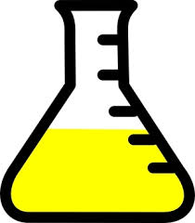
Chemistry
Study of the composition, structure, and properties of matter, the processes that matter undergoes, and the energy changes that accompany these processes.

Slide 6
A. Branches of Chemistry
1. Organic chemistry: the study of most carbon-containing compounds
2. Inorganic chemistry: the study of non-organic substances
3. Physical chemistry: the study of the properties and changes of matter and their relation to energy

Slide 7
A. Branches of chemistry continued
4. Analytical chemistry: the identification of the components and composition of materials
5. Biochemistry: the study of substances and processes occuring in living things
6. Theoretical chemistry: the use of mathematics and computers to understand the principles behind observed chemical behavior and to design and predict the properties of new compounds

Slide 8
A chemical is any substance that has a defined composition.

Slide 9
Basic Research: carried out for the sake of increasing knowledge
Applied Research: carried out to solve a particular problem
Technological Development: involves the production and use of products that improve our quality of life

Slide 10
Test your knowledge
Testing oil slug for the purpose of learning more about it
Why a specific reaction occurs
Biodegradable material
What properties of a substance are
Basic Research
Applied Research
Technological Development
Basic Research

Slide 11
Section 2
Matter and Its Properties

Slide 12
Objectives for section 2
Distinguish between the physical properties and chemical properties of matter
Classify changes of matter as physical or chemical
Explain the gas, liquid, and solid states in terms of particles
Explain how the law of conservation of energy applies to changes of matter.
Distinguish between mixture and a pure substance

Slide 13
Matter
Volume: amount of three dimensional space an object occupies
Mass: measure of the amount of matter
Matter is anything that has mass and takes up space.

Slide 14
Building Blocks of Matter
Atom: smallest unit of an element that maintains the chemical identity of that element
Element: pure substance that cannot be broken down into simpler, stable substances and is made of one type of atom
Compound: substance that can be broken down into simple stable substances. Each compound is made from atoms of two or more elements that are chemically bonded

Slide 15
Properties of Matter
B. Extensive properties: depends on the amount of matter that is present
C. Intensive properties: does not depend on the amount of matter present

Slide 16
Test your Knowledge
Melting Point
Boiling Point
Volume
Density
Mass
Ability to conduct electricity
Hardness
Intensive
Intensive
Extensive
Intensive
Extensive
Intensive
Intensive

Slide 17
Properties and Changes of Matter
D. Physical Property: characteristic that can be observed or measured without changing the identity of the substance
Melting point
Boiling point
Hardness
Physical Changes: change in a substance that does not involve a change in identity of the substance
Cutting
Melting
Boiling
Change of state

Slide 18
Properties and Changes to Matter
E. Chemical Properties: substance’s ability to undergo changes that transform it into different substances
Chemical Changes (reaction): change in which one or more substances are converted into different substances
Burning
Rusting
Oxidizing
Combusting

Slide 19
F. Evidence a chemical change has occurred
Gas production (Bubbles) https://www.youtube.com/watch?v=j7aVLxfsvpg
Precipitant forms (Solid) https://www.youtube.com/watch?v=73dw6w0zNXA
Energy absorbed or released (light, heat) https://www.youtube.com/watch?v=ODf_sPexS2Q
Color change (New substance)

Slide 20
Chemical Reaction
Reactants: substances that react in a chemical change
Products: substances that are formed by chemical change
Carbon + Oxygen
Carbon dioxide
Reactants
Yields
Products

Slide 21
G. States of Matter
1. Solid state: matter has definite volume and definite shape
2. Liquid state: matter has a definite volume but an indefinite shape.
3. Gas state: matter has neither definite volume nor definite shape.
4. Plasma state: high-temperature physical state of matter in which atoms lose most of their electrons

Slide 22
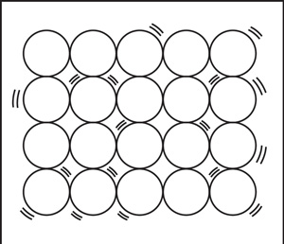
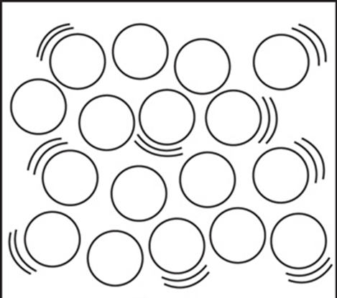
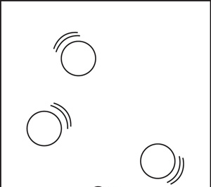
Solid
Packed tightly, vibrating
Liquid
Slide/ Glide past each other
Gas
Moves free, bounces around

Slide 23
Energy and Changes in Matter
Energy is always involved when physical or chemical changes occur
Heat
Light
Energy can be absorbed or released in a change, it NOT created or destroyed (Law of conservation of energy)

Slide 24
Classification of matter
H. Mixture: blend of two or more kinds of matter, each of which retains its own identity and properties. Typically mixed together physically and can be separated
1. Homogeneous mixture: uniform in composition; often called solutions
ex. salt-water solution
2. Heterogeneous mixture: not uniform together
ex. clay-water mixture

Slide 25
I. Separating Mixtures
1. filtration
2. centrifuge
3. chromatography
4. vaporization (evaporating)
5. distillation

Slide 26
Pure Substance
A pure substance has a fixed composition.
Can be compounds or elements
Differ from mixtures by:
Every sample has exactly the same characteristic properties
Every sample has exactly the same composition
Water always has 11.2% H and 88.8% O

Slide 27
Section 3
Elements

Slide 28
Objectives for Section 3
Use a periodic table to name elements, given their symbols
Use a periodic table to write the symbols of elements, given their name
Describe the arrangement of the periodic table
List the characteristics that distinguish metals, nonmetals, and metalloids

Slide 29
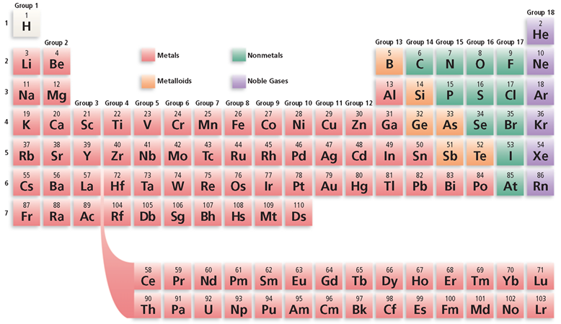
Regions of the Periodic Table

Slide 30
Periodic Table of Elements
Groups or Families: vertical columns of the periodic table
Each group contains elements with similar chemical properties
Periods: horizontal rows on the periodic table
Physical and chemical properties change somewhat regularly across period

Slide 31
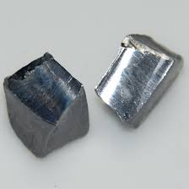
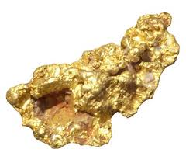
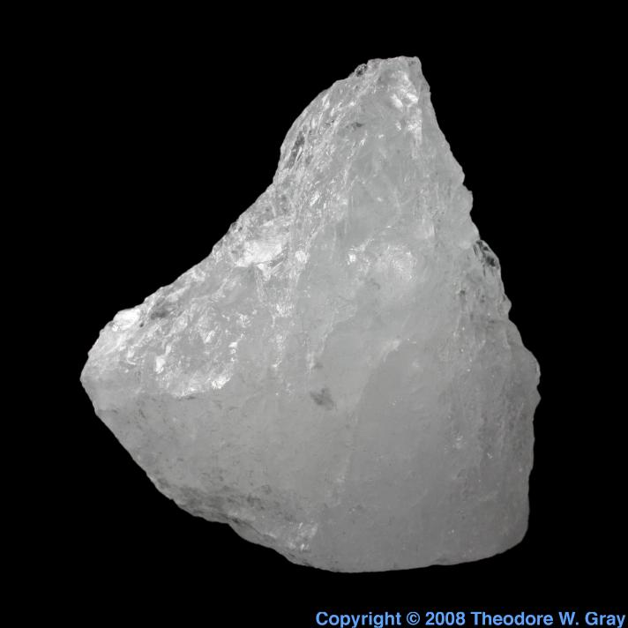
1. Metals
J. Types of Elements
Element that is a good electrical and heat conductor
Properties
Most are solids at room temperature
Malleable- hammered or rolled into thin sheet
Ductile- drawn into a fine wire
Conduct electricity and heat well
Lead
Gold
Potassium

Slide 32
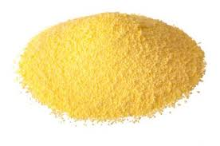
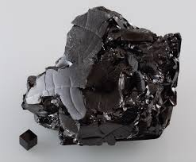
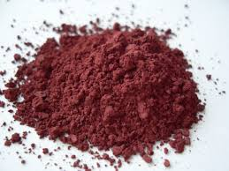
2. Nonmetals
Element that is a poor conductor of heat and electricity
Properties
Many are gases
Solids are brittle
Poor conductors of heat and electricity
Sulfur
Carbon
Phosphorus

Slide 33
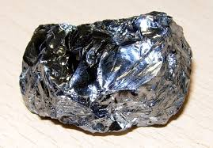
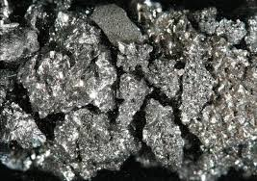
3. Metalloids
J. Types of Elements
Element that has some characteristics of metals and some characteristics of nonmetals
Properties
ALL metalloids are solids at room temperature
Semiconductors of electricity
Silicon
Arsenic

Slide 34
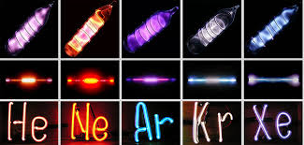
4. Noble Gases
J. Types of Elements
Elements in Group 18 of the periodic table
Generally unreactive
Gases at room temperature

