Slide 1
Quantum Numbers
Orbitals, Spins, and More

Slide 2
Bell Work
Think about your address
Find someone who has the same zip code as you
Then find someone who lives on the same street
Then find someone with the same house number

Slide 3
Electron Location
Just like your address is unique, electrons have unique locations that are identified by their quantum numbers.
Each quantum number provides another piece of the address

Slide 4
Wave-Particle Duality
J.J. Thomson
won the Nobel prize for describing the electron as a particle
His son, George Thomson
won the Nobel prize for describing the wave-like nature of the electron.

Slide 5
Ernest Rutherford’s Model
Discovered dense positive piece at the center of the atom- “nucleus”
Electrons would surround and move around it, like planets around the sun
Atom is mostly empty space
It did not explain the chemical properties of the elements – a better description of the electron behavior was needed

Slide 6
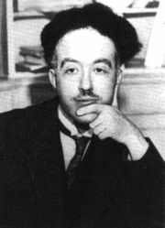
Welcome Louis de Broglie to the Party
French scientist
Suggested that electrons be considered waves confined to the space around an atomic nucleus.
It followed that the electron waves could exist only at specific frequencies.
According to the relationship E = hν, these frequencies corresponded to specific energies—the quantized energies of Bohr’s orbits.
If we combine E=mc² , c=λν, E = 1/2 mv² and E = hν, then we can get:
λ = h/mv de Broglie’s equation
Calculates the wavelength of a particle.

Slide 7
Electrons as Waves
Electrons, like light waves, can be bent, or diffracted.
Diffraction refers to the bending of a wave as it passes by the edge of an object or through a small opening.
Electron beams, like waves, can interfere with each other.
Interference occurs when waves overlap.

Slide 8
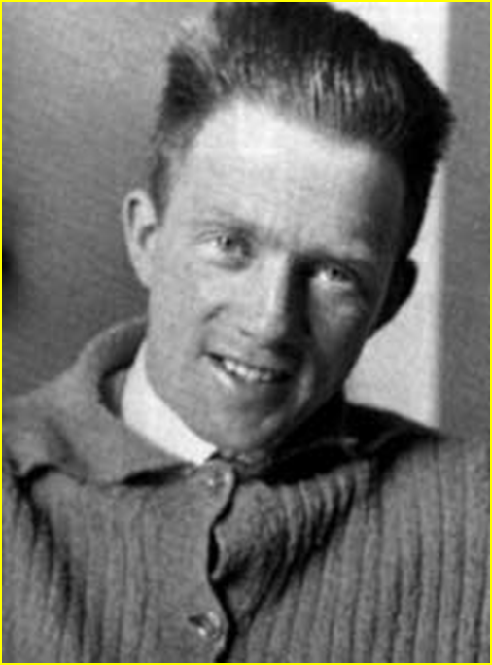
Heisenberg Uncertainty Principle
It is impossible to know exactly the location and velocity of a particle.
The better we know one, the less we know the other.
Measuring changes the properties.
True in quantum mechanics, but not classical mechanics
Werner Heisenberg

Slide 9
Quantum vs Classical Mechanics
Quantum mechanics explains how very small particles behave
Quantum mechanics is an explanation for subatomic particles and atoms as waves
Classical mechanics describes the motions of bodies much larger than atoms

Slide 10
Making Sense of Heisenberg
To measure where a electron is, we use light.
But the light energy moves the electron
And hitting the electron changes the frequency of the light.
SOOOO to measure the location we have to change the velocity and to measure velocity we have to change the location.

Slide 11
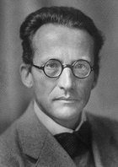
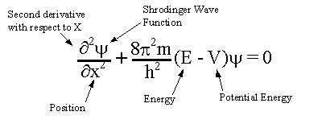
The Schrödinger Wave Equation
In 1926, Austrian physicist Erwin Schrödinger developed an equation that treated electrons in atoms as waves.
Together with the Heisenberg uncertainty principle, the Schrödinger wave equation laid the foundation for modern quantum theory.
Equation for the probability of a single electron being found along a single axis (x-axis)

Slide 12
Quantum Theory
Quantum theory describes mathematically the wave properties of electrons and other very small particles.
Electrons do not travel around the nucleus in neat orbits, as Bohr had postulated.
Instead, they exist in certain regions called orbitals.
An orbital is a three-dimensional region around the nucleus that indicates the probable location of an electron.

Slide 13
The Quantum Model
Things that are very small behave differently from things big enough to see.
The quantum mechanical model is a mathematical solution
It is not like anything you can see (like plum pudding!)
Schrödinger's Cat Paradox

Slide 14
The Quantum Model
Has energy levels for electrons.
Orbits are not circular like Bohr’s Model Predicted
It can only tell us the probability of finding an electron a certain distance from the nucleus.
e⁻ found inside blurry “electron cloud” (area where there’s chance of finding e⁻)

Slide 15
Potentially Great Notes
Quantum Model
Louis de Broglie
e- exists as waves at specific frequencies
can be bent (diffraction) and interfere with each other (interference)
Werner Heisenberg
-Heisenberg Uncertainty Principle
- impossible to determine simultaneously both position and velocity of an e-
Erwin Schrödinger Wave Equation
developed equation to treat e- as waves
responsible for 3 of the 4 quantum numbers

Slide 16
Quantum Numbers
Quantum numbers specify the properties of atomic orbitals and the properties of electrons in orbitals.
Principal quantum number,
symbolized by n, indicates the main energy level occupied by the electron.
Angular momentum quantum number
symbolized by l, indicates the shape of the orbital.
Magnetic quantum number
symbolized by m, indicates the orientation of an orbital around the nucleus.
Spin quantum number
has only two possible values—(+1/2 , −1/2)—which indicate the two fundamental spin states of an electron in an orbital.

Slide 17
Bell Work
On a half sheet, explain Heisenberg’s uncertainty principle.
Turn it in to the tray when you are done.

Slide 18
Predicting Quantum Numbers
n | l (n-1) | m | s
1 |  |  | ±1/2
 | 0,1
3
 |  | -3, -2, -1, 0,1,2,3 | ±1/2

Slide 19
Great Notes
4 Quantum Numbers
Principal Quantum Number (n)- energy level
- distance from nucleus: levels 1-7
Angular Momentum Quantum Number (l= 0,1,2,3)
– shape: s,p,d, or f, ORBITALS
Magnetic Quantum Number (m) – orientation
- x, y, or z axis
Spin Quantum Number (- ½, + ½) - spin
- 2 e- with opposite spin in same orbital
* First 3 Quantum numbers came from Schrödinger's equation

Slide 20
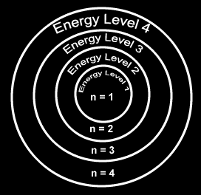
Principal Quantum Number
Principal Quantum Number (n) = the energy level of the electron: 1, 2, 3, etc.
Within each energy level, the complex math of Schrodinger’s equation describes several shapes.
These are called atomic orbitals (coined by scientists in 1932) - regions where there is a high probability of finding an electron.
Sublevels- like theater seats arranged in sections: letters s, p, d, and f

Slide 21
Shapes of Orbitals

Slide 22
Atomic Orbital Shapes (Good Notes)
s = = orbital = 2e⁻
p = = orbitals= 6e⁻
d = = orbitals= 10e⁻
f = = orbitals = 14e⁻
spherical
1
dumbbell
3
cloverleaf
5
complicated
7

Slide 23
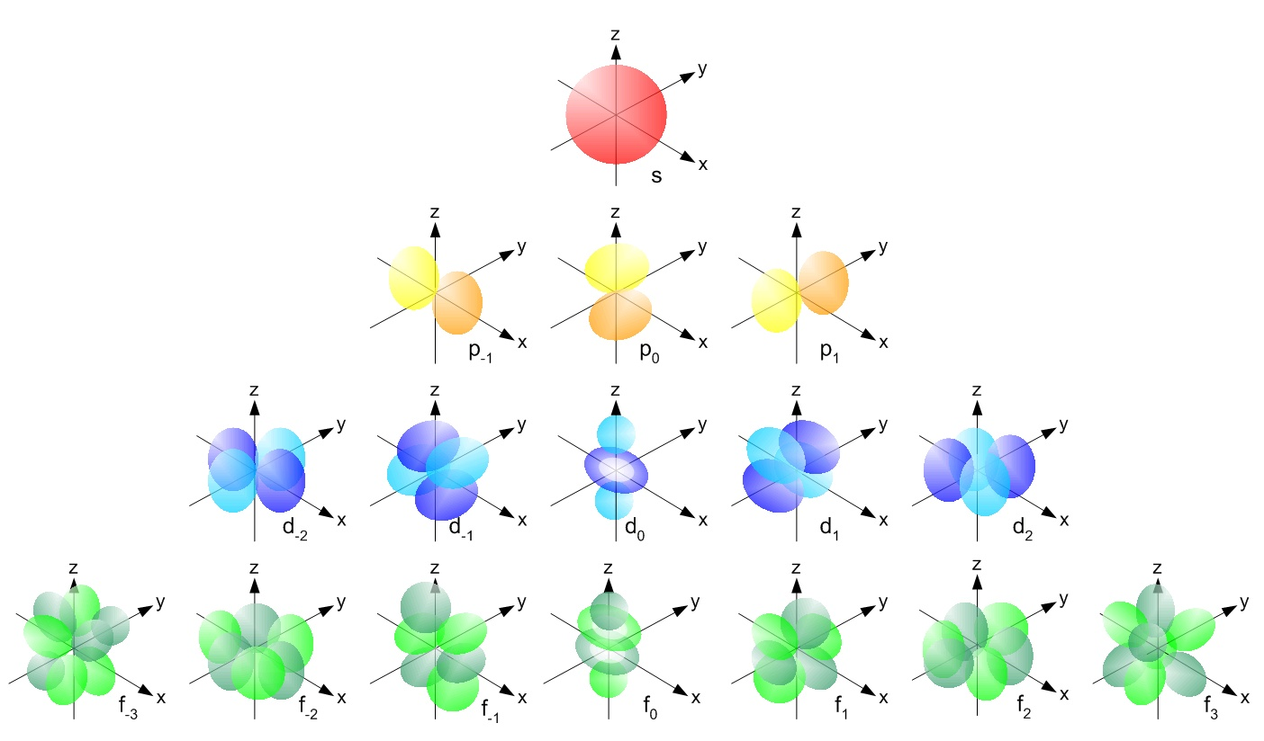
More Orbitals

Slide 24
Orbital Location on the Periodic Table

Slide 25
Electrons Accommodated in Energy Levels

Slide 26
Electrons Accommodated in Energy Levels

Slide 27
Determining Sublevels, Orbitals, Electrons in energy levels and Sublevels
Sublevels = principle quantum number(n)
Orbitals= (2(l)+1)
Electrons in Sublevel= [2(2(l)+1)]
Max # Electrons per energy level = (2n²)

Slide 28
Summary
 | # of shapes (orbitals) | Max number of electrons | Starts at energy level
s | 1 | 2 | 1
p | 3 | 6 | 2
d | 5 | 10 | 3
f | 7 | 14 | 4

Slide 29
By Energy Level
First Energy Level
Has only s orbital
1s² (1 orbital)
2 electrons
Second Energy Level
Has s and p orbitals available
2 in s, 6 in p
2s²2p⁶ (4 orbitals)
8 total electrons

Slide 30
By Energy Level
Third Energy Level
Has s, p, and d orbitals
2 in s, 6 in p, and 10 in d
3s²3p⁶3d¹⁰
18 total electrons
Fourth Energy Level
Has s, p, d, and f orbitals
2 in s, 6 in p, 10 in d, and 14 in f
4s²4p⁶4d¹⁰4f¹⁴
32 total electrons

Slide 31
Great Notes
Energy Levels
1 = 1 sublevel = 1s² =
2 = 2 sublevels = 2s², 2p⁶ =
3 = 3 sublevels = 3s², 3p⁶, 3d¹⁰ =
4 = 4 sublevels = 4s², 4p⁶, 4d¹⁰, 4f¹⁴ =
2e⁻
8e⁻
18e⁻
32e⁻

Slide 32
Sec 4.2 Practice Problems
1. How many sublevels are in the following principal energy levels? List the sublevels.
a. n = 1
b. n = 2
c. n = 3
d. n = 4
1 sublevel
1s²
2 sublevel
2s² 2p⁶
3 sublevel
3s² 3p⁶ 3d¹⁰
4 sublevel
4s² 4p⁶ 4d¹⁰ 4f¹⁴

Slide 33
Practice Problems 4.2
2. How many orbitals are in the following sublevels?
a. 1s sublevel e. 4f sublevel
b. 5s sublevel f. 7s sublevel
c. 3p sublevel g. 6d sublevel
d. 4d sublevel h. fourth principal energy level
1
7
1
1
3
5
5
16

Slide 34
Practice Problems 4.2
3. How many electrons are in the following sublevels?
a. 1s sublevel e. 4f sublevel
b. 5s sublevel f. 7s sublevel
c. 3p sublevel g. 6d sublevel
d. 4d sublevel h. fourth principal energy level
2 e-
14 e-
2 e-
2 e-
6 e-
10 e-
10 e-
32 e-

